Slide 1

Scalability of Web Systems Remote Procedure Calls

Slide 2
3 Tier Architecture
Client
Web server(s)
Application server(s)
Database server(s)
Server
Web
Application Logic
DBMS

Slide 3
HTTP
An HTTP session is a sequence of request-response interactions.
A request is a method applied on a URI:
Methods: GET, PUT, POST, HEAD, OPTIONS, DELETE, TRACE, CONNECT, PATCH
URI: Universal Resource Identifier
URL: Universal Resource Locator
A response is a status code and a message body

Slide 4
Request/response
Using HTTP to support distributed applications:
How can a client call a procedure on the server?
How to deal with scale?

Slide 5
Outline
Remote Procedure Call
Procedure Call
Strong modularity constraints
Caller/Callee/Stubs
Dealing with failures
Dealing with Scale
Alternatives
REST
Message Queues and Transactional Message Passing
gRPC
Protocol Buffers
gRPC
Etcd

Slide 6
CS Fundamental Abstractions
Memory
Interpreter
Communication

Slide 7
Interpreter Abstraction
Source: Saltzer and Kaashoek
Environment reference
Instruction reference
Memory
Retrieve next instruction
Instructions
Instruction repertoire
Interpret
instruction
Data
Interrupt
signal?
Yes
No
Change instruction and environment reference
Instruction reference: where to find next instruction
Repertoire: set of actions associated to an instruction
Environment reference: where to find the current state on which the interpreter should perform the actions of the current instruction
Interpreter

Slide 8
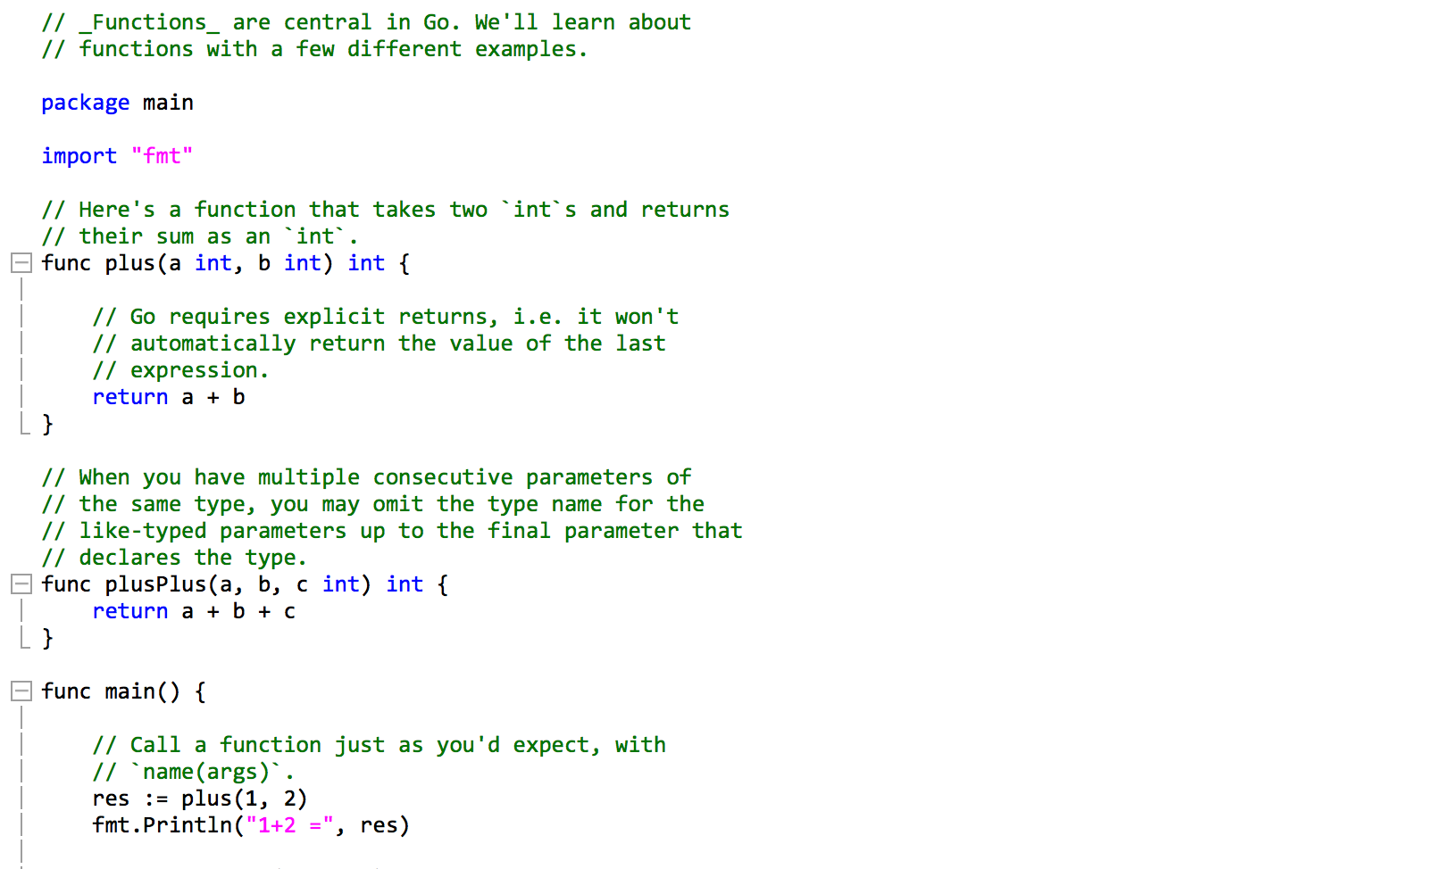
Procedure Call

Slide 9
Procedure Call
Space for local variables
Stack
growing up
Return address
Arguments
Saved temp registers
Space for local variables
Shared Address Space:
- Stack to manage interpreter state
- Direct mapping from function name to address in memory
- Soft modularity => error propagates among caller/callee

Slide 10
Strong Modularity
Caller and callee located on different computers that do not share memory:
Errors do not automatically propagate
Need for mechanisms to deal with:
Naming
Managing the interpreter state
Dealing with failure

Slide 11
Client/server
Client
Server
Put argument into
message
Wait for request
REQUEST
time
Wait for response
Get argument from request
Compute
RESPONSE
Put results into response
Get result from response

Slide 12
Explicit vs. implicit Client/Server
Message Passing
Vs.
Remote Procedure Call

Slide 13
RPC
Client
Server
plus(1,5)
plus(a,b)
…
return a+b
6
Client Stub
Server Stub

Slide 14
RPC
Client Stub
Service Definition
=
Interface
Definition
Server Stub

Slide 15
Naming
Hardcoded vs. name service
Name service:
Publish (server) and Discovery (client)
Key-value pairs
K: Procedure name
V: Server address

Slide 16
Marshalling / Unmarshalling
It is most efficient to represent arguments and response in binary format within request/response:
Compact
Independent from programming language
Mapping from program data types to binary representation: marshalling/unmarshalling (communication). Also called serialisation/deserialisation (storage)

Slide 17
RPC
Client
Server
plus(1,5)
plus(a,b)
…
return a+b
6
Client Stub
Server Stub

Slide 18
RPC Failure Handling
Client
Server
plus(1,5)
plus(a,b)
…
return a+b
6
Timer-based
Alternative server
Client Stub
Server Stub

Slide 19
RPC Semantics
At-most once:
If no response, return an error to the caller.
At-least once:
If no response, resend until a response is received.
Exactly once:
Fault-tolerant bookeeping on client and server stubs avoids duplicate calls to the service

Slide 20
Dealing with Scale
Large number of requests per server:
Need for decoupling of stub and server program through some form of queue
Multiple servers per request:
Need for load balancing
On client, proxy or load balancer

Slide 21
Outline
Remote Procedure Call
Procedure Call
Strong modularity constraints
Caller/Callee/Stubs
Dealing with failures
Dealing with Scale
Alternatives
REST
Message Queues and Transactional Message Passing
gRPC
Protocol Buffers
gRPC
Etcd

Slide 22
REST
Introduced by Roy Fielding
Stateless client-server interaction
Make it possible to cache, clone the server
Session state managed on the client
State is carried into the requests/responses
Shared understanding of data types between client and server
No need for marshalling/unmarshalling
Resources on server and associated representation on client
Standardized interface to access/modify resources

Slide 23
HTTP-Based RESTful APIs
A resource is identified by its URI
Representation encoded as semi-structured data: JSON or XML
HTTP verbs mapped to CRUD actions on a resource
GET: access to a resource
PUT: replace the resource
POST: append the resource
DELETE: delete from the resource

Slide 24
Message Queues
How to make RPC:
Asynchronous?
Transactional (exactly once semantic)?
Client
Server
M0

Slide 25
Message Queues
By storing messages on client or server and maintaining/exchanging metadata to ensure transactional semantics (ACID)
Client
Server
M0

Slide 26
Message Queues
By storing messages on client or server and maintaining/exchanging metadata to ensure transactional semantics (ACID)
Client
Server
M0

Slide 27
Outline
Remote Procedure Call
Procedure Call
Strong modularity constraints
Caller/Callee/Stubs
Dealing with failures
Dealing with Scale
Alternatives
REST
Message Queues and Transactional Message Passing
gRPC
Protocol Buffers
gRPC
Etcd

Slide 28
Protocol Buffers
https://developers.google.com/protocol-buffers/
https://github.com/google/protobuf
Protocol buffers are a language-neutral, platform-neutral extensible mechanism for serializing structured data.
Protocol buffers are Google’s data interchange format.

Slide 29
Protocol Buffers
Data access class (Go)
Message
(Structured Data) Definition
.proto file
Protocol Buffer
compiler
Data access class (Java, Python, C++, C#)

Slide 30
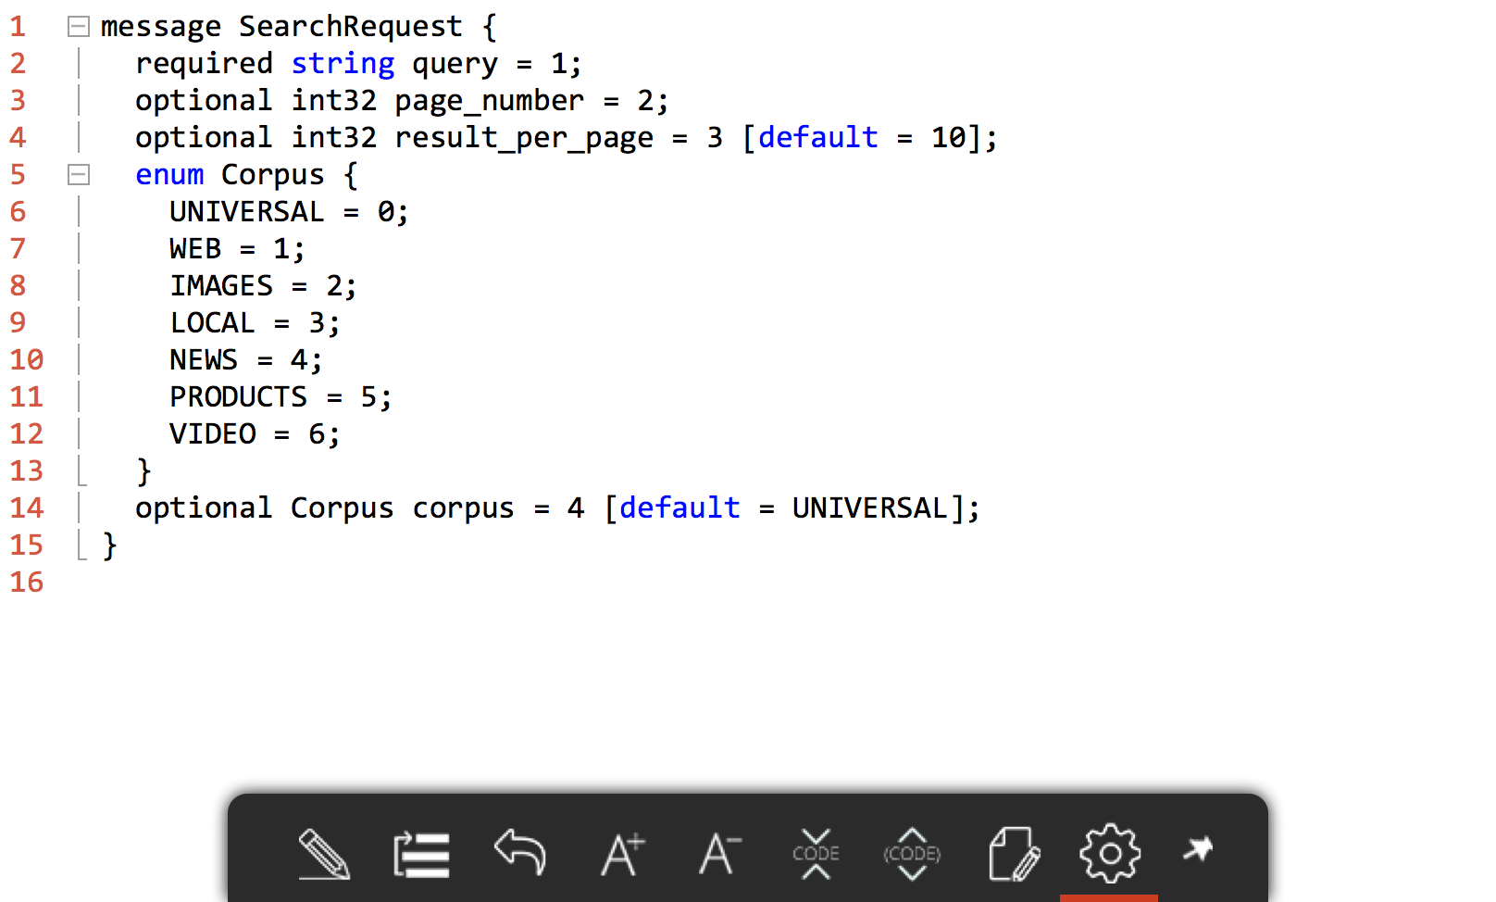
ProtoBuf Language
https://developers.google.com/protocol-buffers/docs/proto

Slide 31
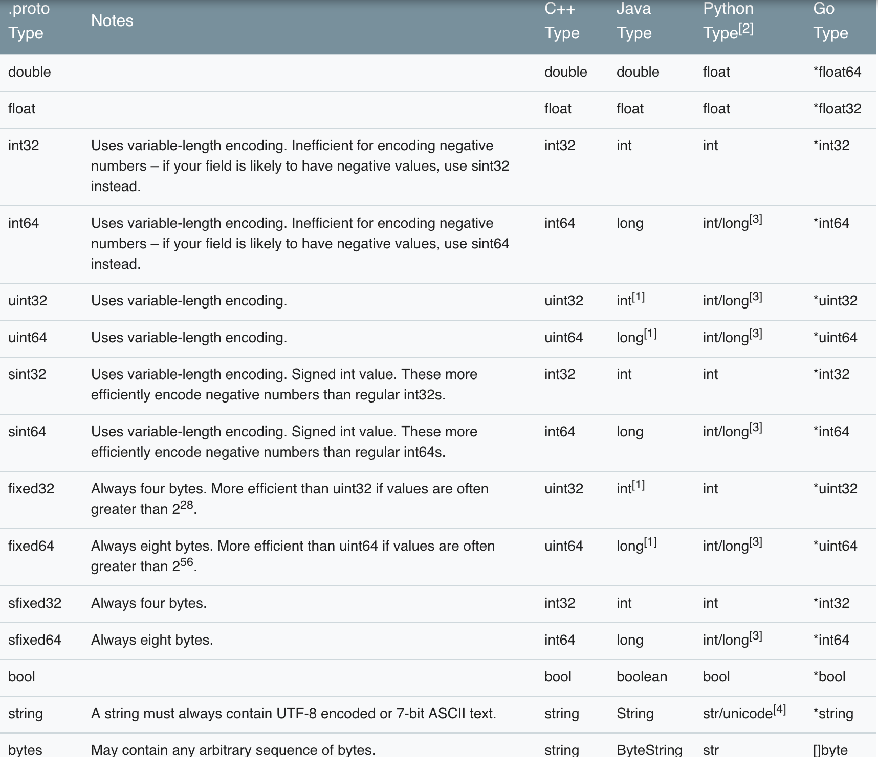
ProtoBuf Types
https://developers.google.com/protocol-buffers/docs/proto

Slide 32
Marshalling/unmarshalling
Messages defined in .proto file
Language-specific access classes generated with protocol buffer compiler
Marshalling/unmarshalling provided by language specific Protocol buffer library

Slide 33
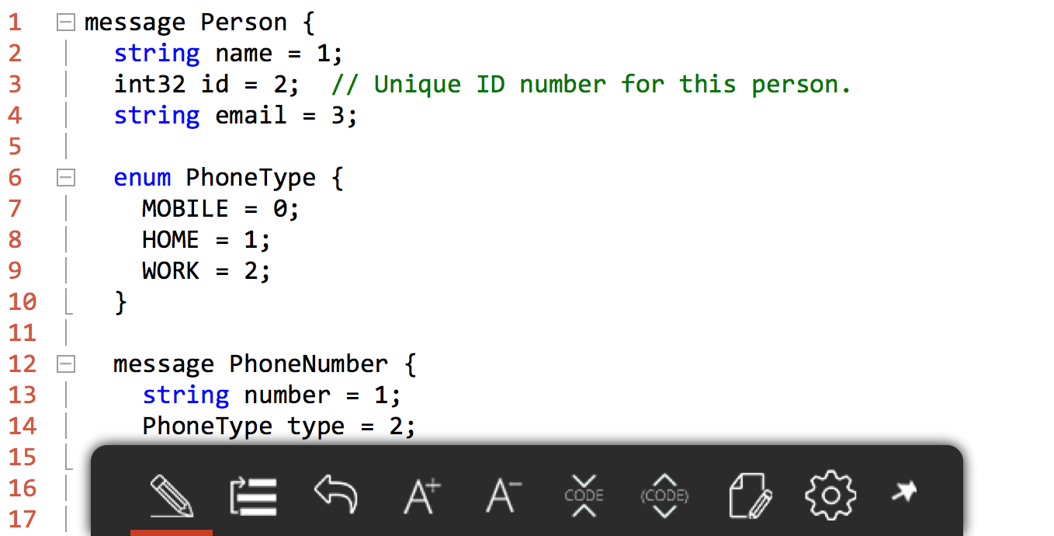
addressBook.proto

Slide 34
Protocol Buffer Compilation
% protoc --go_out=. addressbook.proto

Slide 35
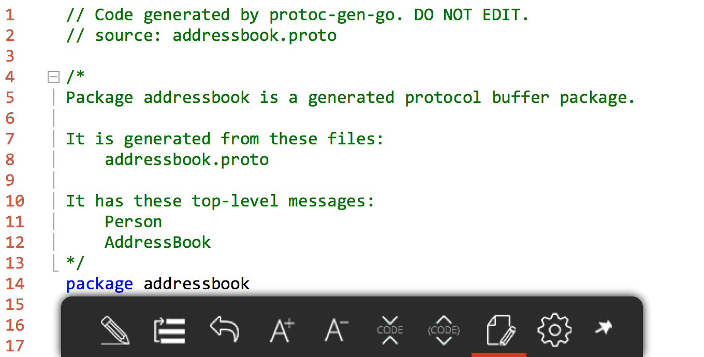
Access Class
https://developers.google.com/protocol-buffers/docs/reference/go-generated

Slide 36
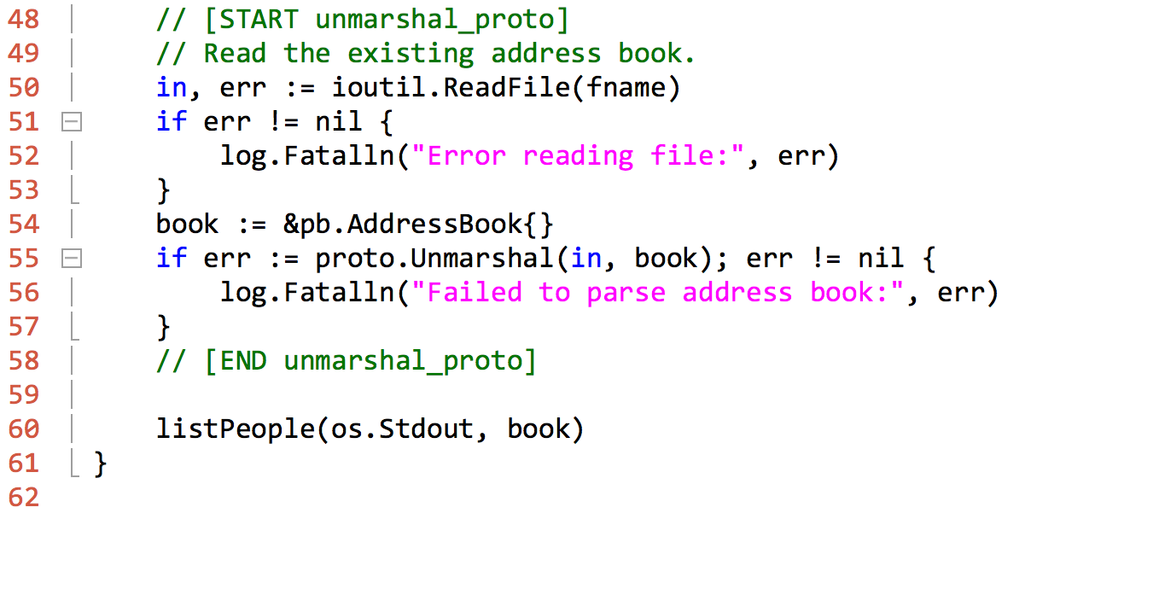
Programming with Protocol Buffers
https://godoc.org/github.com/golang/protobuf/proto

Slide 37
gRPC
https://grpc.io/
Protocol Buffers used to define the gRPC service, and the parameters/return types for rpc functions.

Slide 38
RPC
Client
Server
.proto file
(1) Request/
Response type
(2) Rpc services
plus(1,5)
plus(a,b)
…
return a+b
6
Client Stub
Server Stub

Slide 39
gRPC
4 modes of requests/responses:
(simple) Client sends a requests and waits for one response
(server-side streaming) Client sends a requests and gets a stream of responses back.
(client-side streaming) Client sends a stream of requests and waits for the server to send a response.
(bi-directional streaming) Client and server send streams of requests/responses independently. The order of messages in each stream is preserved.

Slide 40
gRPC
https://grpc.io/docs/guides/wire.html
Wire protocol based on HTTP2
Request/response headers as HTTP2 headers.
Request/response body delivered as HTTP delimited messages items. They are represented as data frames.

Slide 41
gRPC
Server implementation:
Provide implementation for the service interface
Run a gRPC server that listens to requests, calls the appropriate stubs and services and returns the response(s).

Slide 42
gRPC
Client implementation:
Create gRPC channel, a connection to the server
Get a client handle from the protocol buffer service
RPC function as protocol buffer service call based on the client handle.

Slide 43
etcd
https://coreos.com/etcd/
https://coreos.com/etcd/docs/latest/dev-guide/grpc_naming.html
Etcd is a distributed key value store that provides reliable data storage across machines.
Etcd can be used as gRPC name service.
Etcd accessible through gRPC.
Etcd is written in Go.

Slide 44
Take-Aways
Client
Server
.proto file
(1) Request/
Response type
(2) Rpc services
plus(1,5)
plus(a,b)
…
return a+b
6
Client Stub
Server Stub

Slide 45
Take-Aways
RPC is not a procedure call because of failure handling.
Three semantics:
At most once
At least once
Exactly once
gRPC relies on protocol buffers for service/messages definition. It is implemented on top of HTTP2.

